Slide 1
Notes:
Boardworks Science
Plate tectonics

Slide 2
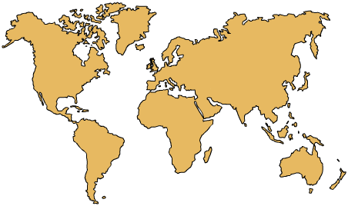

How does the Earth’s surface change?
The shapes and positions of the continents make up a very familiar image.
The Earth’s surface is a very dynamic place and has not always looked like this.
Earthquakes, volcanic activity and other phenomena have been changing the face of the planet for millions of years.
The key geological theory that explains how the Earth’s surface changes now and has changed in the past is called plate tectonics.
So what exactly is the theory of plate tectonics and how was it developed?
Notes:
Boardworks Science
Plate tectonics

Slide 3


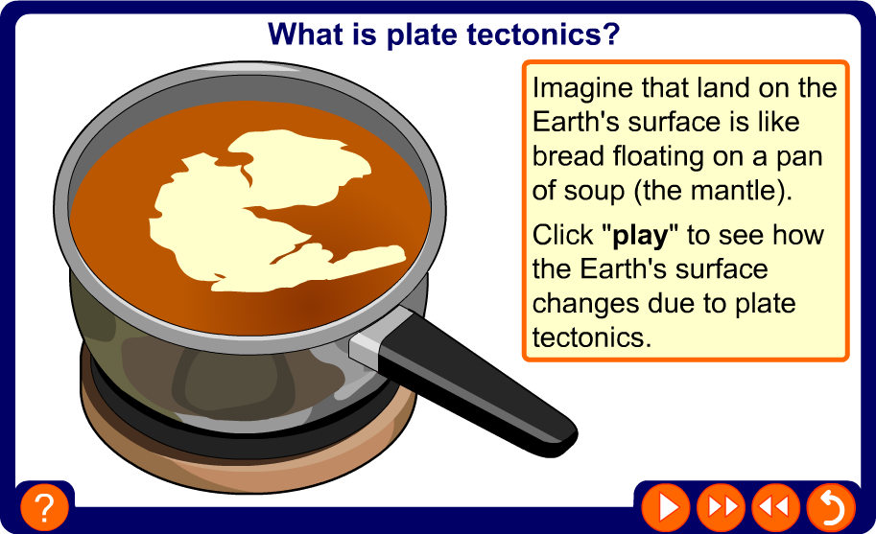
Introducing plate tectonics
Notes:
Boardworks Science
Plate tectonics
Teacher notes
This four-stage interactive animation about plate tectonics using the metaphor of boiling soup to help enable students to visual this concept. Suitable prompts could include:
Stage 1: Why aren’t we normally aware of the movement of the Earth’s crust?
Stage 2: What is the effect of the crusts moving apart?
Stage 3: What is the effect of the crusts moving towards each other?
Stage 4: How do the plate boundaries relate to areas of volcanic activity and earthquakes?

Slide 4
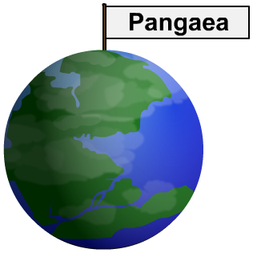
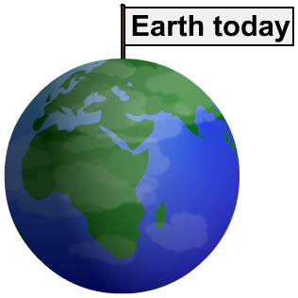
Have the continents moved?
Alfred Wegener was a key figure in changing ideas about the Earth’s surface. In 1912, he proposed that all the continents were once joined in a single supercontinent, called Pangaea.
Wegener suggested that Pangaea began to break up about 200 million years ago and the pieces drifted apart to form the present day continents.
At the time, Wegener’s theory of ‘continental drift’ was dismissed by geologists because he could not provide a convincing explanation for how the continents were able to move.
Notes:
Boardworks Science
Plate tectonics

Slide 5
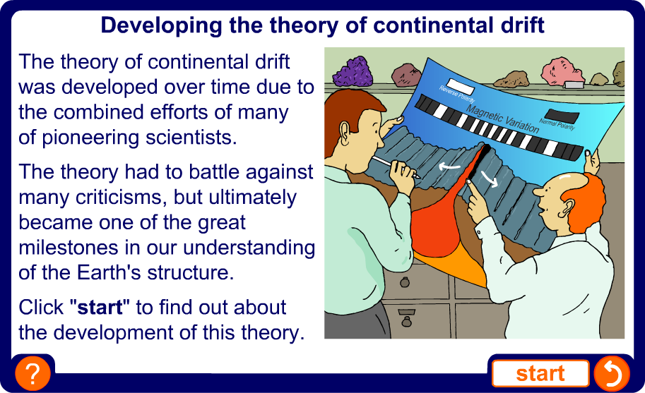
How was Wegener’s theory developed?
Notes:
Boardworks Science
Plate tectonics
Teacher notes
This historical sequence could be used to explore how science works. While viewing the sequence, it could be highlighted that it can take time for new theories to be absorbed into body of scientific knowledge and this is often reliant on gathering more evidence to support the theory.
In this example, although Wegener’s theory initially met with scepticism, later research using new submarine technology provided further evidence to support his theory.

Slide 6
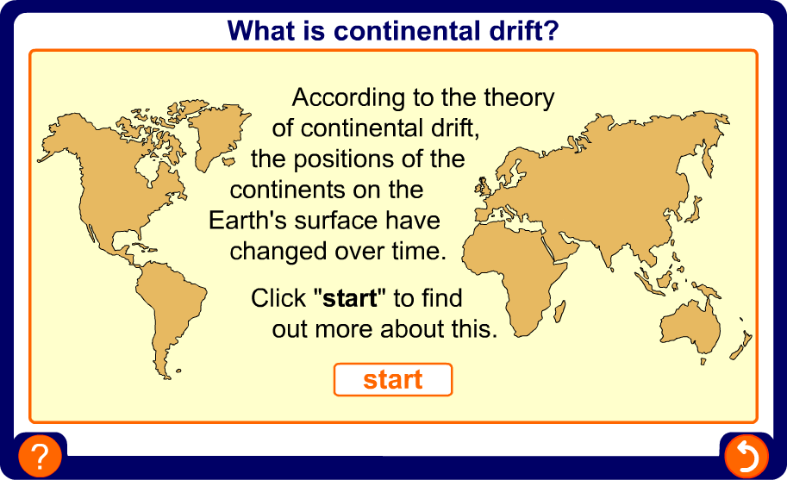
How have the continents changed?
Notes:
Boardworks Science
Plate tectonics
Teacher notes
This interactive activity enables students to explore how the contents have changed. While viewing the sequence, the jigsaw fit of the continents could be highlighted.

Slide 7
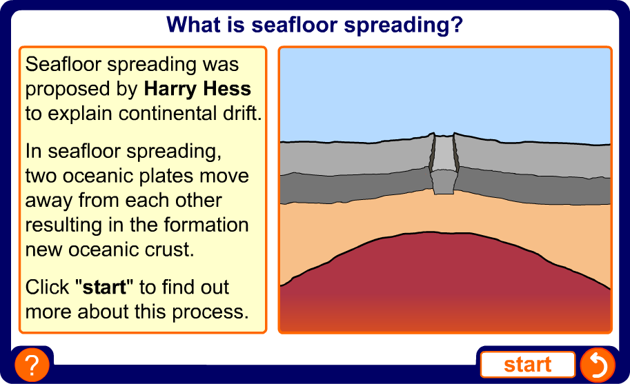
What is seafloor spreading?
Notes:
Boardworks Science
Plate tectonics
Teacher notes
This interactive sequence explores the theory of seafloor spreading, as proposed by Harry Hess. When viewing the animation, the importance of convection currents and the use of GPS to indirectly observe sea floor spreading could be highlighted.

Slide 8
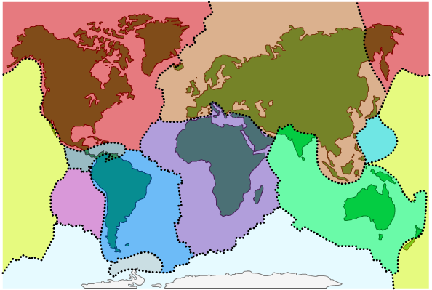
What is the theory of plate tectonics?
The explanation for how the continents move came from observations of seafloor spreading and other effects. In 1967, these ideas were linked in the theory of plate tectonics.
According to this theory, the Earth’s crust is like a jigsaw puzzle made up of giant sections called tectonic plates.
These plates ‘float’ on top of the mantle and so can move around the Earth’s surface.
There are 10 major tectonic plates and several minor plates.
Notes:
Boardworks Science
Plate tectonics

Slide 9
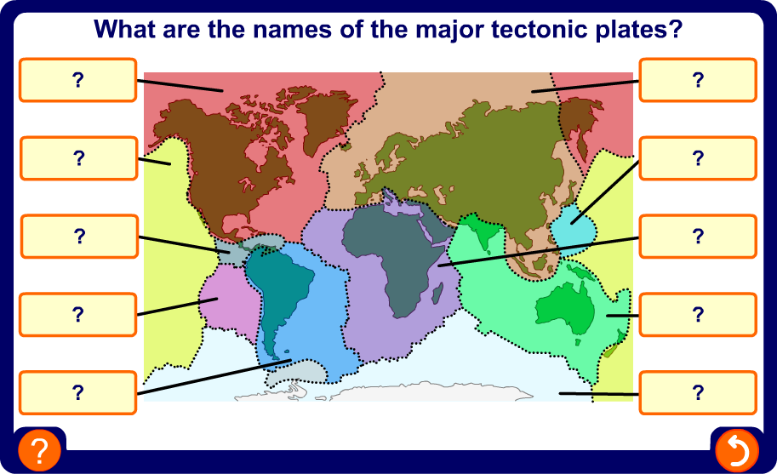
What are the major tectonic plates?
Notes:
Boardworks Science
Plate tectonics
Teacher notes
This drag and drop activity could be used as a plenary exercise to check students’ ability to identify the major tectonic plates.
The map could also be used to start a discussion about the occurrence of earthquakes and volcanoes in certain parts of the world.

Slide 10
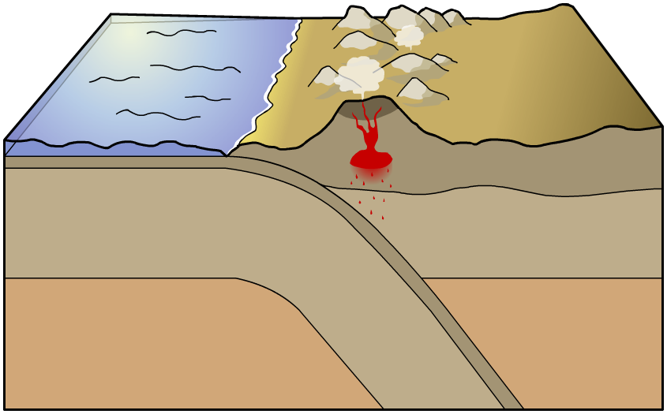
What is a plate boundary?
The area where two tectonic plates meet is called a plate boundary. Mountains, volcanoes and oceanic trenches are formed at plate boundaries, and earthquakes are more likely to occur here.
continental crust
trench
There are three types of plate boundary: divergent, convergent and destructive. Each type is characterized by how the plates and the geological effects of this movement.
Notes:
Boardworks Science
Plate tectonics

Slide 11
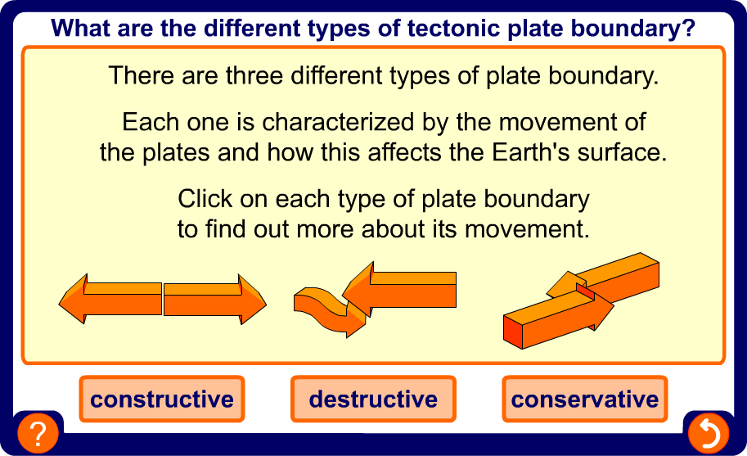
Identifying plate boundaries
Notes:
Boardworks Science
Plate tectonics
Teacher notes
This three-stage interactive sequence uses animated arrow diagrams to illustrate the movement that occurs at different plate boundaries. It could be used as an introductory topic or for revision. While using the activity, the link between geological hazards and certain movements could be highlighted. Students could be asked to produce similar illustrations in their books.
The animated sequence on the next slide provides a more in-depth look at plate boundaries.

Slide 12
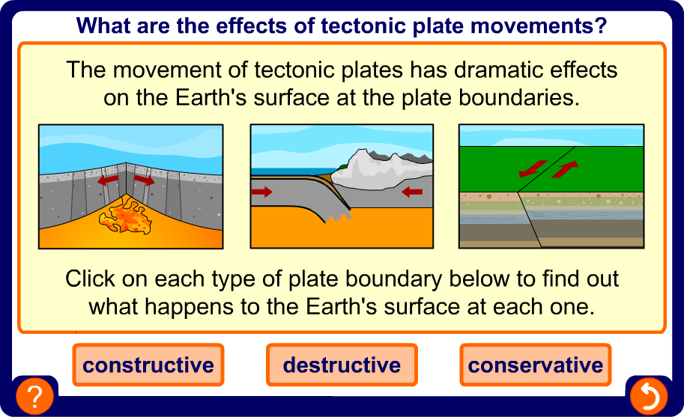
Effects of tectonic plate movements
Notes:
Boardworks Science
Plate tectonics
Teacher notes
This three-stage interactive animated sequence provides a more detailed look at the three types of plate boundaries and introduces some new terminology. While viewing the destructive plate boundary animation, the difference in thickness between oceanic and continental plates should be stressed. The cyclic nature of the destruction and formation of plate material could also be highlighted.
It is important to stress that although no new plate material is formed at a conservative boundary, this does not mean these boundaries are geologically stable but are in fact very prone to earthquakes.

Slide 13
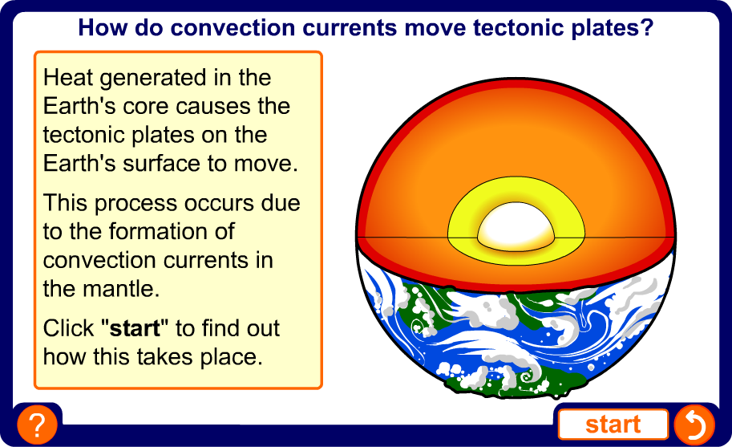
How do tectonic plates move?
Notes:
Boardworks Science
Plate tectonics
Teacher notes
This three-stage interactive animation illustrates how convection currents cause the movement of tectonic plates. Suitable prompts could include:
Stage 1: What type of chemical reaction causes the lower mantle to heat up?
Stage 2: Where else do convection currents occur? Suitable examples include boiling water or coastal breezes.
Stage 3: What happens when the two plates collide?

Slide 14
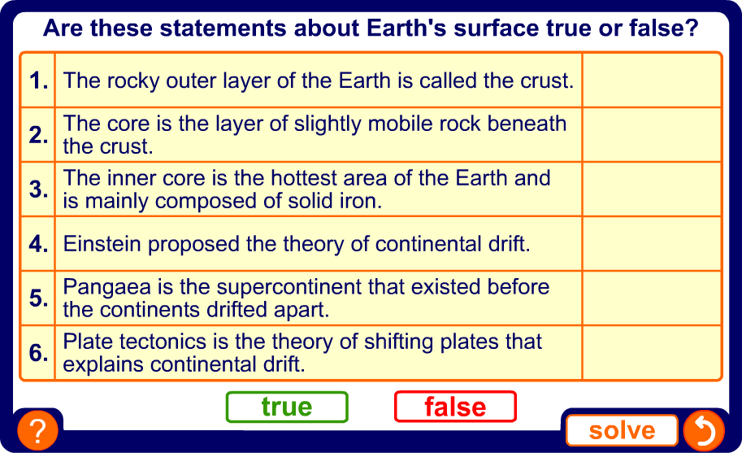
Plate tectonics – true or false?
Notes:
Boardworks Science
Plate tectonics
Teacher notes
This true-or false activity could be used as a plenary or revision exercise on plate tectonics, or at the start of the lesson to gauge students’ existing knowledge of the subject matter. Coloured traffic light cards (red = false, yellow = don’t know, green = true) could be used to make this a whole-class exercise.

Slide 15
Key points about plate tectonics
The theory of plate tectonics explains the movement of, and changes to, the Earth’s crust. The key points are:
The Earth's surface is made up of several huge tectonic plates (like pieces of a jigsaw puzzle) that are continually moving.
The ocean floors are continually moving, spreading from the centre and sinking at the edges.
Earthquakes and volcanoes occur at plate boundaries, where the tectonic plates meet.
Convection currents in the mantle move the tectonic plates on the Earth’s surface. The source of the heat driving the convection currents is radioactive decay deep within the Earth’s core.
Notes:
Boardworks Science
Plate tectonics

